Slide 1
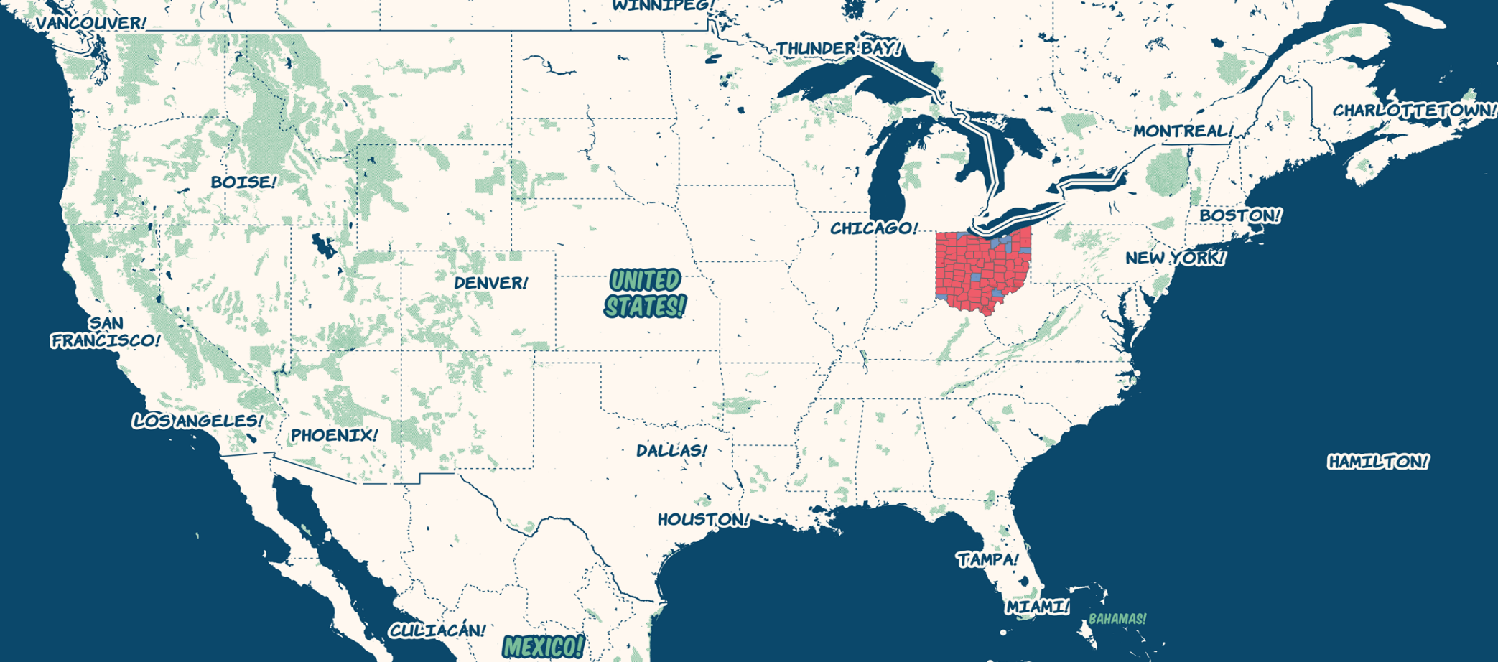
US Presidential Election Ohio 2016

Slide 2
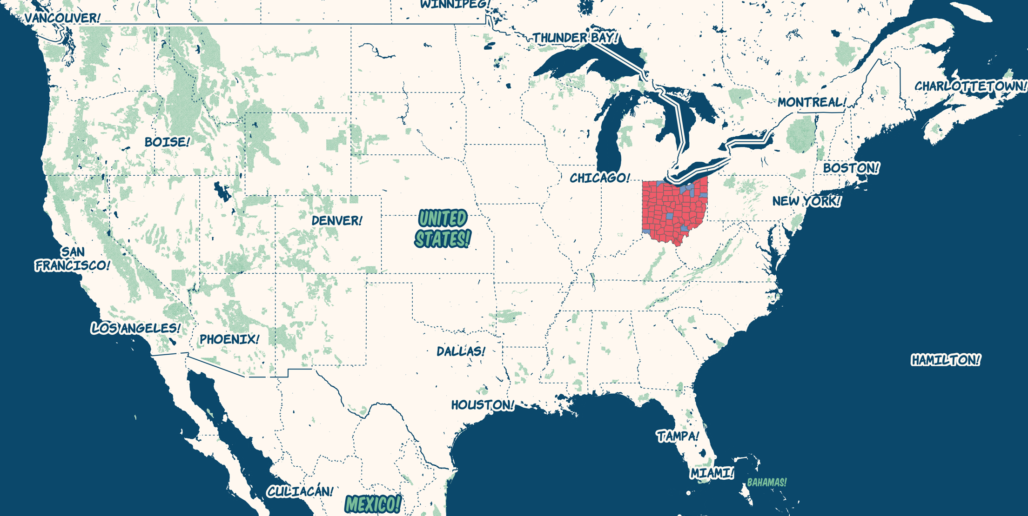

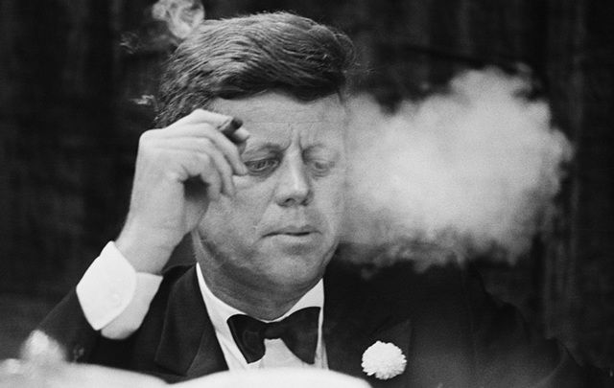
Why Ohio?

Slide 3
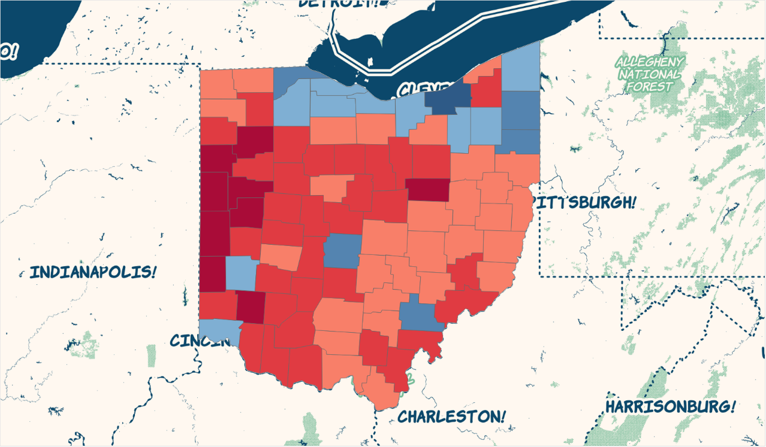
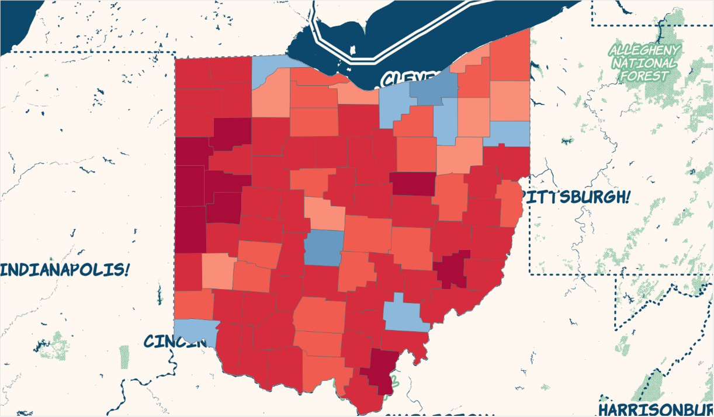
Ohio Electoral Map 2012 vs 2016
2016
2012

Slide 4
Ohio Electoral Map – Swing Counties

Slide 5
Ohio Electoral Map – Dem Density

Slide 6
Ohio Electoral Map – GOP Density

Slide 7
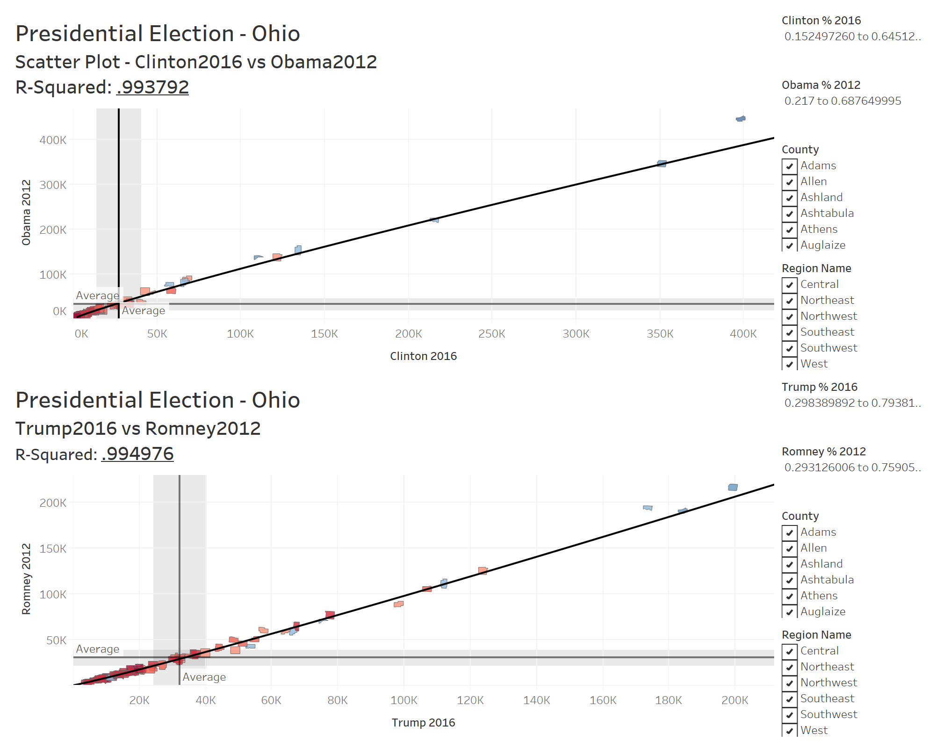
Ohio Electoral Map – Correlation

Slide 8
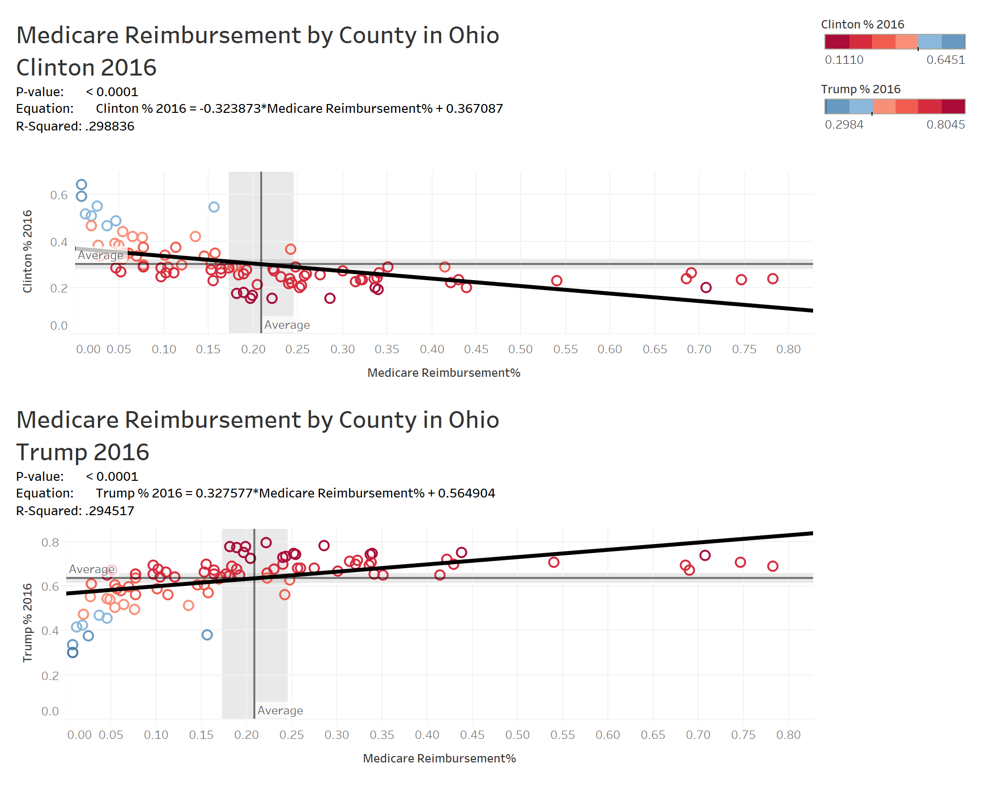
Medicare Reimbursement in Ohio by County, 2014

Slide 9
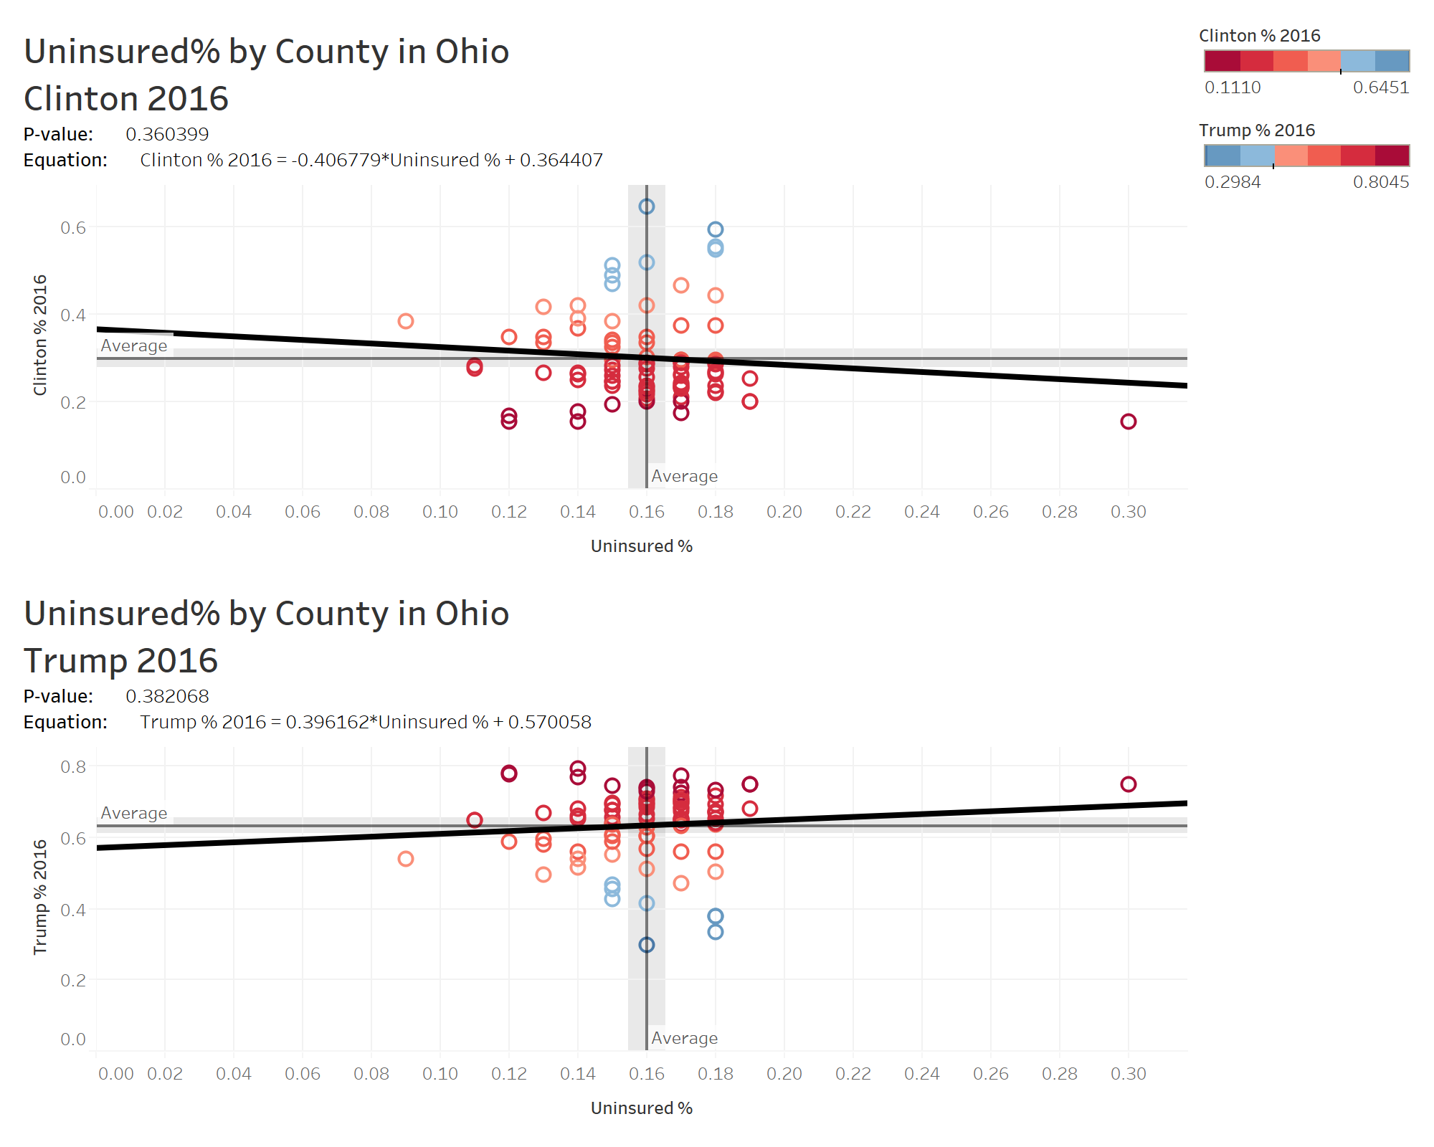
Uninsured Percentage in Ohio by County, 2016

Slide 10
Median Household Income in Ohio by County, 2016

Slide 11
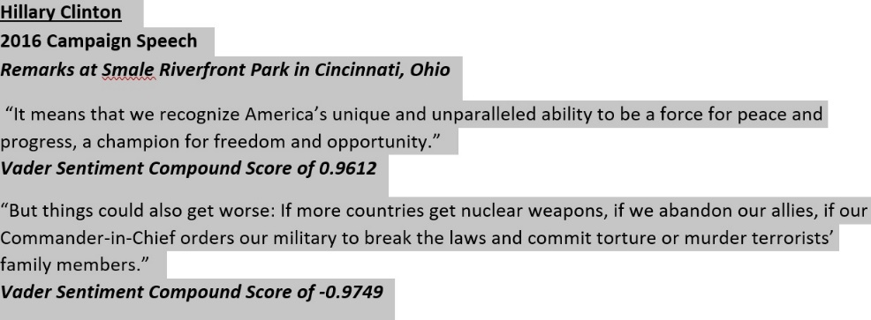
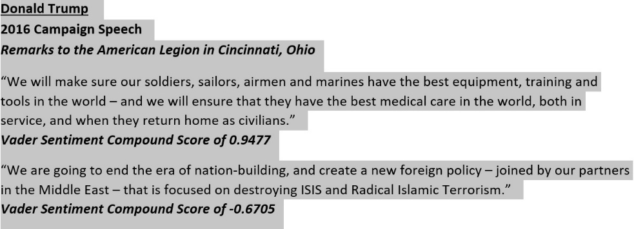
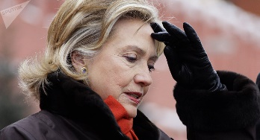
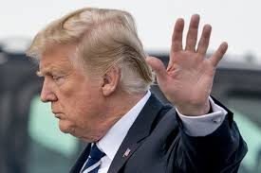


Cincinnati

Slide 12
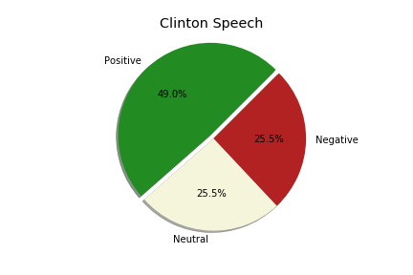
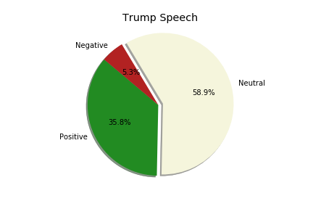
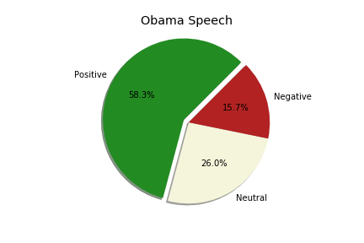
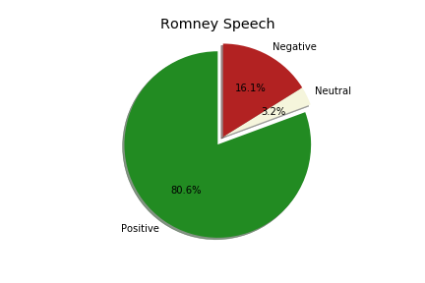
Cincinnati Speech Sentiment

Slide 13
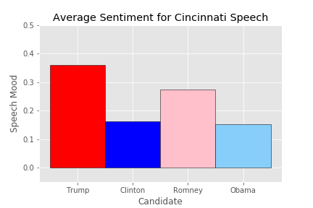
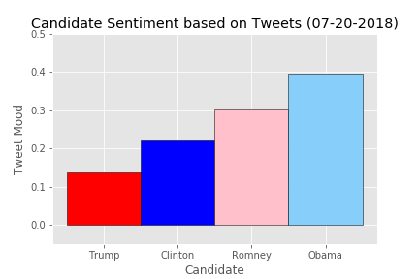
Compound Score, Cincinnati Speech & Tweets

Slide 14
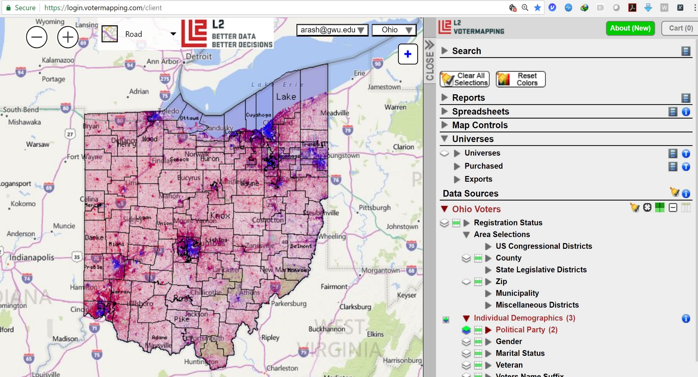
Ohio Electoral Map – L2 Voter File

Slide 15
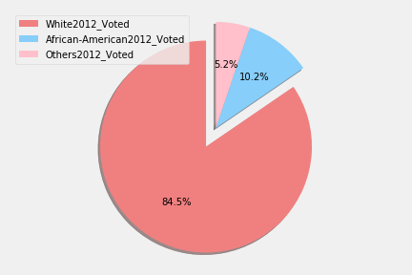
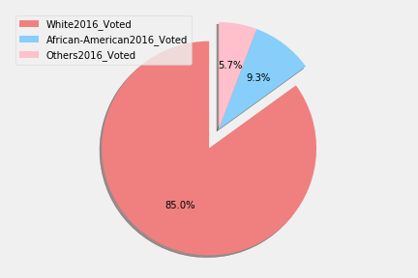
2012 vs 2016: Ethnicity_Voted
2016
2012

Slide 16
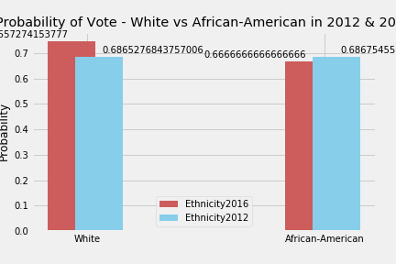
2012 vs 2016: Ethnicity_P(Vote)

Slide 17
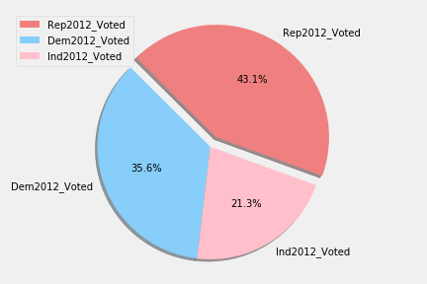
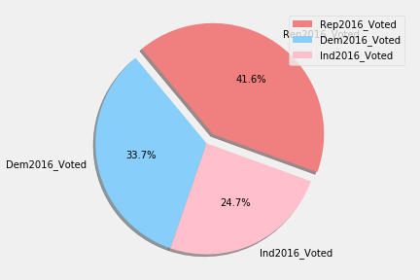
2012 vs 2016: Party-Affiliation_Voted
2016
2012

Slide 18
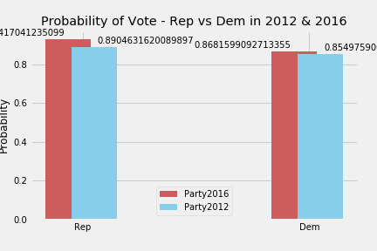
2012 vs 2016: Party-Affiliation_P(Vote)

Slide 19
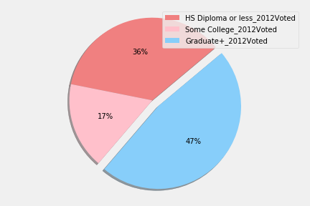
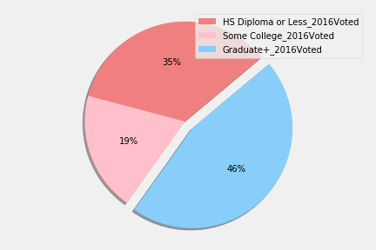
2012 vs 2016: Education_Voted
2016
2012

Slide 20
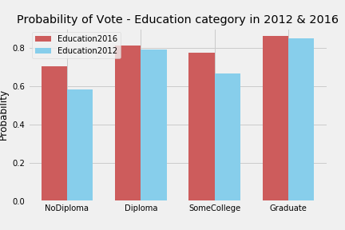
2012 vs 2016: Education_P(Vote)

Slide 21
Wrap Up, & What Next
Ethnicity
Education
Modeling

Slide 22
THANK YOU
ohIO is OHio,
http://github.com/arashghafouri
https://github.com/tpinon007
https://github.com/harriskl1
https://github.com/mplusc

